Slide 1
What steps can be taken to increase SAT participation?

Slide 2
Reviewed Test Participation Data for ACT and SAT
Collected data from 2017, 2018 and 2019 for both tests
Cleaned up dataset by removing duplicate information, and removing unnecessary data
Established the mean total and composite scores for each test, as well as the mean participation rate.
Initially studied the correlation between SAT Participation Rates and SAT Total Score
Found that the lower the participation rate is the higher the mean score for the state. This is due to selective testing by individuals

Slide 3
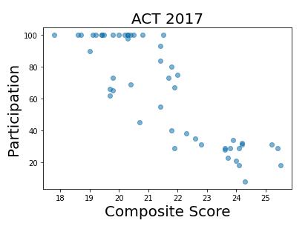
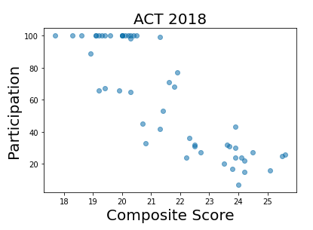
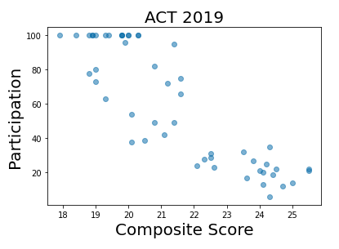
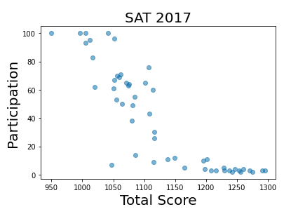
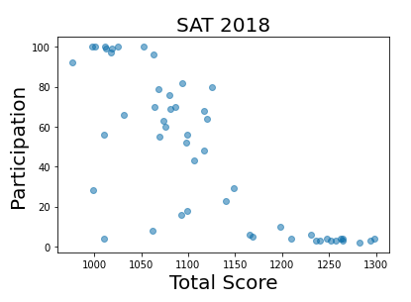
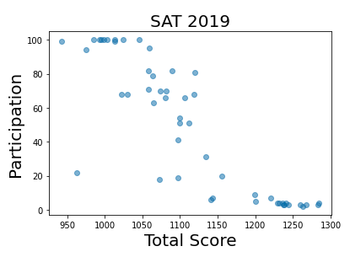

Slide 4
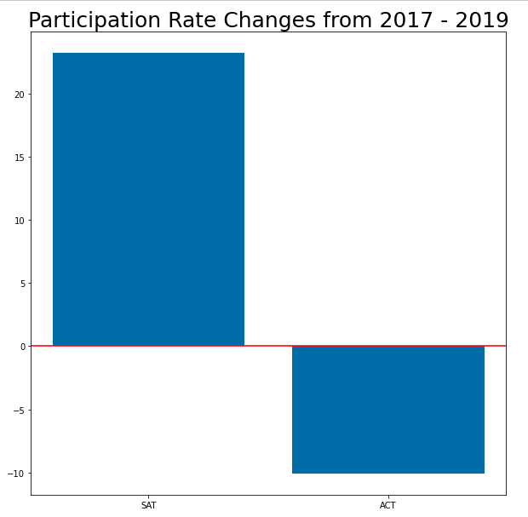
Participation rate means across the states have increased by 23% for the SAT while at the same time decreasing by 10% for the ACT.
It appears that Colorado, Illinois, and West Virginia had changes to their State Mandates, while a handful of other states increased their use of the SAT School Day.

Slide 5
Expanding to Michigan
In 2015 it was announced that Michigan switched from Mandatory ACT to Mandatory SAT.
This was accomplished primarily by presenting a bid of $17.1 Million, three-year contract
This contract beat the competitor bid from ACT of $32.5 Million
From this we can see that competitive bidding is a major part of securing increase participation in the mandatory testing area

Slide 6
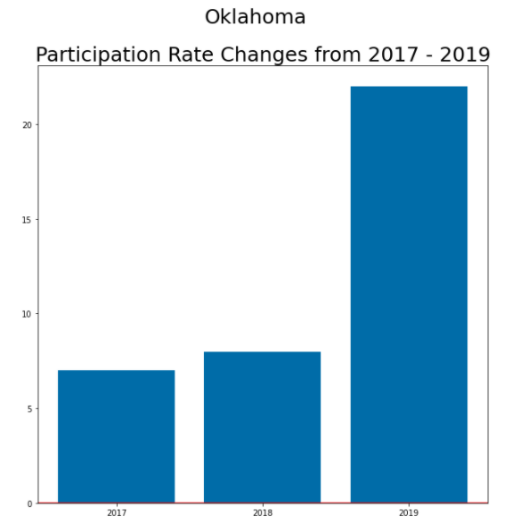
How to keep improving participation in Oklahoma?
Unlike Michigan, Oklahoma does not have a state mandate for the SAT, but the participation rate has increased over 100 percent since the SAT School Day has began to pick up steam in the state.

Slide 7
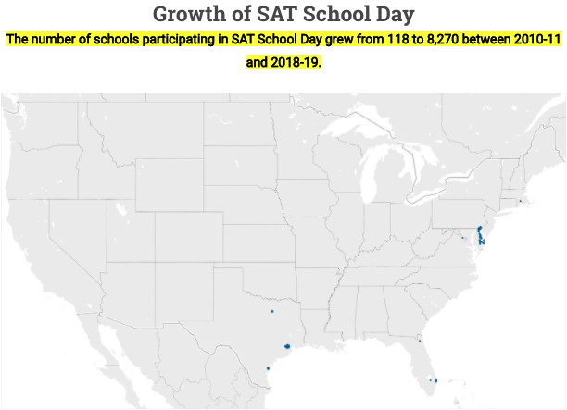
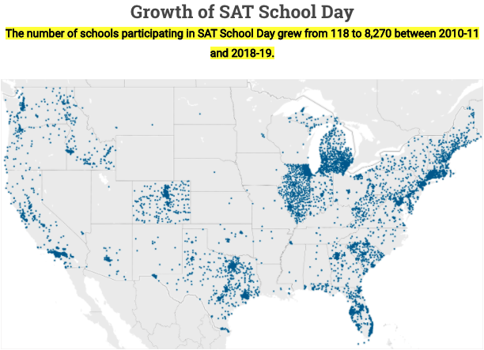
The success of SAT School Day

Slide 8
Continue Expanding Participation in SAT School Day
According to data, the SAT School Day program has continued to increase participation by allowing students to take the test during school hours.
Participation in the program has grown from three states in 2014 to nearly every state and 960,000 students in 2019
Many states and school districts are offering the test at no costs.
Every effort should be made to lobby continued expansion of the initiative in underrepresented areas

Slide 9
Additional Ideas on Expansion
Localized lobbying efforts with municipalities and state governments to encourage participation and/or mandate.
Coordination with organizations on providing resources for test fees
Dedicated resources to assist with grants for local/state agencies to assist with test fees
Consider offering online/virtual proctored tests
Focus efforts on more rural areas

Slide 10
Considerations for Expansion
As participation increases,
Cost for implementation will increase
Mean test scores will decrease
When expanding to rural areas, there are less resources and opportunities for student prep

Slide 11
Source Materials
College Board
https://www.collegeboard.org/releases/2018/more-than-2-million-students-in-class-of-2018-took-sat-highest-ever
https://reports.collegeboard.org/sat-suite-program-results/class-2019-results
Detroit Free Press
https://www.freep.com/story/news/local/michigan/2015/01/07/michigan-replaces-act-sat/21385299/

